Slide 1
SE SW Competency Task Force(SSCTF)
SSC Task Force
Anju Bala
Arabinda Verma
Chetan Sai Kumar T
Prathap HS
Vikas Agrawal
Veeraj S Khokale
Sasikumar Sathasivam
Class - 3

Slide 2
Scope
Main objective is to focus on Key Algorithms/Methods that are frequently covered in Advance SW Competency Test.
Target is to get good understanding and Hands On Experience.
Tips - Dos and Don’t.
Test problems will be covered.
Out of Scope:
No intension to cover regular advance C programming training for various data structure and algorithms. That has to be covered through SRIB training.
PS: however invite the major concern that you feel to be addressed in this task force.

Slide 3
Practice: Advance Test –Sales Booth – Jan’16
Samsung wants to introduce the promotions in mobile sale. They want to setup a booth to sell mobile phones. They will club all areas of same mobile model with 1 single booth. In areas(marked zero), where samsung mobile is not established , they will consider selling the mobiles that are famous in adjacent areas of higher configuration.
Input
5 | 5 | 1 | 4 | 4
4 | 0 | 2 | 4 | 2
5 | 0 | 0 | 2 | 0
5 | 4 | 3 | 0 | 1
1 | 3 | 3 | 2 | 1
Output
5 | 5 | 1 | 4 | 4
4 | 5 | 2 | 4 | 2
5 | 5 | 5 | 2 | 2
5 | 4 | 3 | 3 | 1
1 | 3 | 3 | 2 | 1
11 booths
Traversal allowed in TOP,BOTTOM, LEFT or RIGHT
 | 5
5 | 0 | 3
 | 4
Here zero is covered by S5 maximum no.of times and hence the new area zero will be addressed by S5 booth
Practice

Slide 4
Java solution - Algorithm
For program queries , please contact
Chetan Sai Kumar, chetan.sk@samsung.com
Main Aim: Setting up the booth
Understanding of Problem:
Identifying the location of Zeros
Checking how many zeros are together
Finding higher configuration around the group of zeros identified
Replace zeros and store
Constraints:
Group of zeros must be replaced with higher configuration
No two group of zeros are interlinked. (All groups are independent)

Slide 5
Galaxy Sale Booth – Java Solution Flowchart
Since we need to consider each group of zeros separately we need a duplicate array (Constraint 2)
Here to make sure we don’t end up in infinite loop we need to maintain visited array
Start
Read the inputs in to an 2D array
Top
(i-1,j)
Area==0
(i, j)& not visited
Top
(i-1,j)
No
Yes
Right
(i,j+1)
Right
(i,j+1)
Left
(i,j-1)
All visited
Left
(i,j-1)
Down
(i+1,j)
Down
(i+1,j)
Increment of Count of Cn
Cn==Pn & not visited
Yes
This recursion is used for grouping the zeros
A
Find maximum of all the counts and replace Zeros (constraint 1)

Slide 6
Galaxy Sale Booth – Java Solution Flowchart
Now traverse through the updated array to count number of booths
For program queries , please contact
Chetan Sai Kumar, chetan.sk@samsung.com
A
Top
(i-1,j)
Visited?
Yes
Right
(i,j+1)
No
Left
(i,j-1)
After one successful recursion increment booth count
Down
(i+1,j)
Cn==Pn & not visited
Yes
Print booth count as output
Stop

Slide 7
.cpp solution
For program queries , please contact
Veeraj S Khokale, veeraj.sk@samsung.com
Pseudo code/ Flow chart

Slide 8
Minimum Spanning Tree -Kruskal's algorithm -Prim's algorithm Class-3
Compiled by Sasikumar

Slide 9
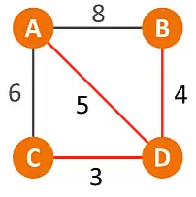
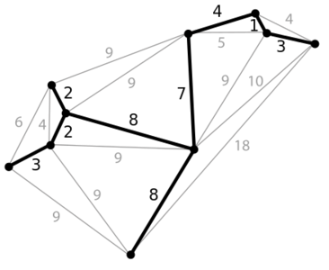
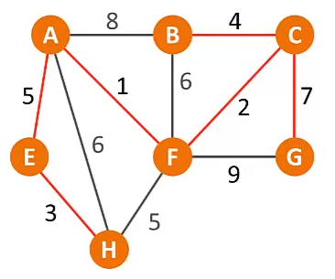
Minimum Spanning Tree(MST)
A minimum spanning tree is a spanning tree of a connected, undirected graph. It connects all the vertices together with the minimal total weighting for its edges.
A single graph can have many different spanning trees with minimum cost.

Slide 10
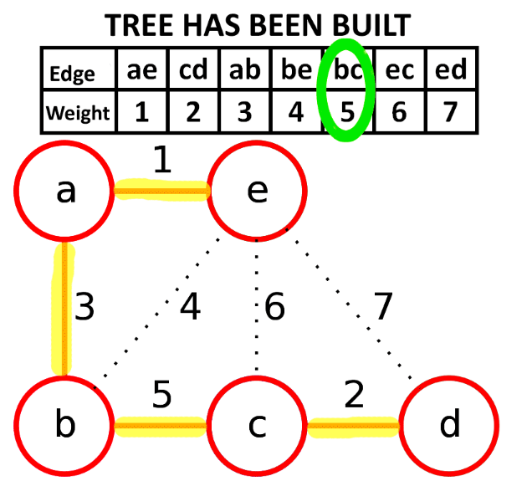
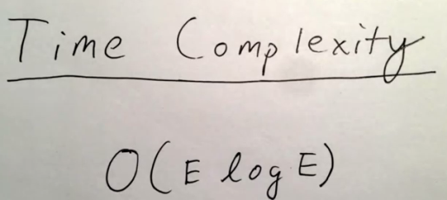
Kruskal’s Algo - Algorithm
Kruskal's algorithm is a minimum-spanning-tree algorithm which finds an edge of the least possible weight that connects any two trees in the forest.^{[1]} It is a greedy algorithm in graph theory as it finds a minimum spanning tree for a connected weighted graph adding increasing cost arcs at each step.
KRUSKAL(G):
1 A = ∅
2 foreach v ∈ G.V:
3 MAKE-SET(v)
4 foreach (u, v) ordered by weight(u, v), increasing:
5 if FIND-SET(u) ≠ FIND-SET(v):
6 A = A ∪ {(u, v)}
7 UNION(u, v)
8 return A

Slide 11
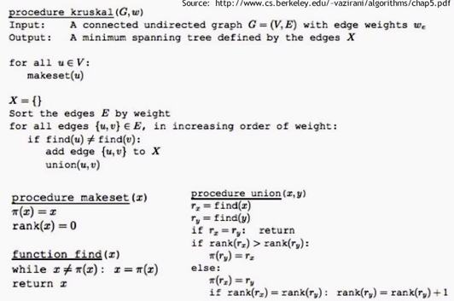
Kruskal’s Algo – pseudo code
Kruskal Algo
1. Sort all the edges in non-decreasing order (similar to ascending) of their weight.
2. Pick the smallest edge. Check if it forms a cycle with the spanning tree
formed so far. If cycle is not formed, include this edge. Else, discard it.
3. Repeat step#2 until there are (V-1) edges in the spanning tree.

Slide 12
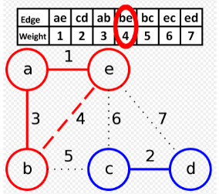
Kruskal’s Algorithm - MST
http://107.108.206.159/Adv_Test_Video/Kruskals%20Algorithm%20for%20Minimum%20Spanning%20Trees.mp4
OR
https://www.youtube.com/watch?v=Rc6SIG2Q4y0
Another one: http://107.108.206.159/Adv_Test_Video/Kruskal's%20algorithm%20in%202%20minutes%20%97%20Review%20and%20example.mp4
Or https://www.youtube.com/watch?v=71UQH7Pr9kU
C:\Users\sasikumar\Documents\Temp\SE\SE-SW COMPETENCY TASK FORCE\Classes
\\sasikumar\SW Comp -Algo Videos
Video name: Kruskals Algorithm for Minimum Spanning Trees.mp4
Animation: https://en.wikipedia.org/wiki/File:MST_kruskal_en.gif

Slide 13
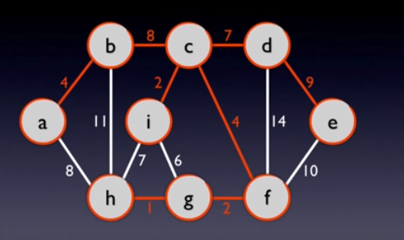
Kruskal’s –MST
#include<stdio.h> #include<conio.h> #include<stdlib.h>
int i,j,k,a,b,u,v,n,ne=1;
int min, mincost=0, cost[9][9], parent[9];
int find(int);
int uni(int,int);
void main()
{
printf("\n\n\tImplementation of Kruskal's algorithm\n\n");
printf("\nEnter the no. of vertices\n");
scanf("%d",&n);
printf("\nEnter the cost adjacency matrix\n");
for(i=1;i<=n;i++)
{ for(j=1;j<=n;j++)
{
scanf("%d", &cost[i][j]);
if(cost[i][j]==0)
cost[i][j]=999;
}
}
printf("\nThe edges of Minimum Cost Spanning Tree are\n\n");
while(ne<n)
{ for(i=1,min=999; i<=n; i++)
{
for(j=1; j<=n; j++)
{
if(cost[i][j]<min)
{
min=cost[i][j];
a=u=i;
b=v=j;
}
}
}
u=find(u); v=find(v);
if(uni(u,v))
{ printf("\n%d edge (%d,%d) =%d\n",vne++,a,b, min);
mincost +=min;
}
cost[a][b]=cost[b][a]=999;
}
printf("\n\tMinimum cost = %d\n",mincost);
}
int find(int i)
{
while(parent[i])
i=parent[i];
return i;
}
int uni(int i, int j)
{
if(i!=j)
{
parent[j]=i;
return 1;
}
return 0;
}
Find Cycle
 |  | 1 | 2 | 3 | 4 | 5 | 6 | 7 | 8 | 9
 |  | a | b | c | d | e | f | g | h | i
1 | a | 0 | 4 | 0 | 0 | 0 | 0 | 0 | 8 | 0
2 | b | 4 | 0 | 8 | 0 | 0 | 0 | 0 | 11 | 0
3 | c | 0 | 8 | 0 | 7 | 0 | 4 | 0 | 0 | 2
4 | d | 0 | 0 | 7 | 0 | 9 | 14 | 0 | 0 | 0
5 | e | 0 | 0 | 0 | 9 | 0 | 10 | 0 | 0 | 0
6 | f | 0 | 0 | 4 | 14 | 10 | 0 | 2 | 0 | 0
7 | g | 0 | 0 | 0 | 0 | 0 | 2 | 0 | 1 | 6
8 | h | 8 | 11 | 0 | 0 | 0 | 0 | 1 | 0 | 7
9 | i | 0 | 0 | 2 | 0 | 0 | 0 | 6 | 7 | 0
Finding min cost
Find Cycle
Replace current cost with 999 so that next scan will not pick the same minimum.

Slide 14
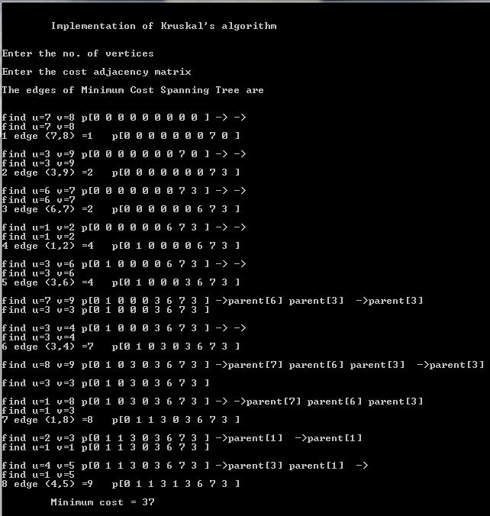
Kruskal’s –MST
#include<stdio.h> #include<conio.h> #include<stdlib.h>
int i,j,k,a,b,u,v,n,ne=1;
int min, mincost=0, cost[9][9], parent[9];
int find(int);
int uni(int,int);
void main()
{
printf("\n\n\tImplementation of Kruskal's algorithm\n\n");
printf("\nEnter the no. of vertices\n");
scanf("%d",&n);
printf("\nEnter the cost adjacency matrix\n");
for(i=1;i<=n;i++)
{ for(j=1;j<=n;j++)
{
scanf("%d", &cost[i][j]);
if(cost[i][j]==0)
cost[i][j]=999;
}
}
printf("\nThe edges of Minimum Cost Spanning Tree are\n\n");
while(ne<n)
{ for(i=1,min=999; i<=n; i++)
{
for(j=1; j<=n; j++)
{
if(cost[i][j]<min)
{
min=cost[i][j];
a=u=i;
b=v=j;
}
}
}
u=find(u); v=find(v);
if(uni(u,v))
{ printf("\n%d edge (%d,%d) =%d\n",vne++,a,b, min);
mincost +=min;
}
cost[a][b]=cost[b][a]=999;
}
printf("\n\tMinimum cost = %d\n",mincost);
}
int find(int i)
{
while(parent[i])
i=parent[i];
return i;
}
int uni(int i,int j)
{
if(i!=j)
{
parent[j]=i;
return 1;
}
return 0;
}
parent
 |  | 1 | 2 | 3 | 4 | 5 | 6 | 7 | 8 | 9
 |  | a | b | c | d | e | f | g | h | i
1 | a | 0 | 4 | 0 | 0 | 0 | 0 | 0 | 8 | 0
2 | b | 4 | 0 | 8 | 0 | 0 | 0 | 0 | 11 | 0
3 | c | 0 | 8 | 0 | 7 | 0 | 4 | 0 | 0 | 2
4 | d | 0 | 0 | 7 | 0 | 9 | 14 | 0 | 0 | 0
5 | e | 0 | 0 | 0 | 9 | 0 | 10 | 0 | 0 | 0
6 | f | 0 | 0 | 4 | 14 | 10 | 0 | 2 | 0 | 0
7 | g | 0 | 0 | 0 | 0 | 0 | 2 | 0 | 1 | 6
8 | h | 8 | 11 | 0 | 0 | 0 | 0 | 1 | 0 | 7
9 | i | 0 | 0 | 2 | 0 | 0 | 0 | 6 | 7 | 0
Cycle u=v
Cycle u=v
Cycle u=v
Cycle u=v

Slide 15
Krushal - cpp
#include <iostream>
#include <algorithm>
#include <iterator>
const int MX = 1000;
struct Edge { int u, v, w; } edge[MX*MX];
int N, M, parent[MX];
int find(int i) { while (parent[i]) i = parent[i]; return i; }
void my_union(int i, int j) { parent[i] = j; }
int main()
{
scanf("%d%d", &N, &M);
for (int i = 0; i < M; ++i)
scanf("%d%d%d", &edge[i].u, &edge[i].v, &edge[i].w);
std::sort(edge, edge+M, [](const Edge &e1, const Edge &e2) { return e1.w < e2.w; });
int cost = 0;
for (int i = 0; i < M; ++i)
{
int u = find(edge[i].u), v = find(edge[i].v);
if (u != v)
{
my_union(u, v);
cost += edge[i].w;
}
}
printf("%d\n", cost);
return 0;
}

Slide 16
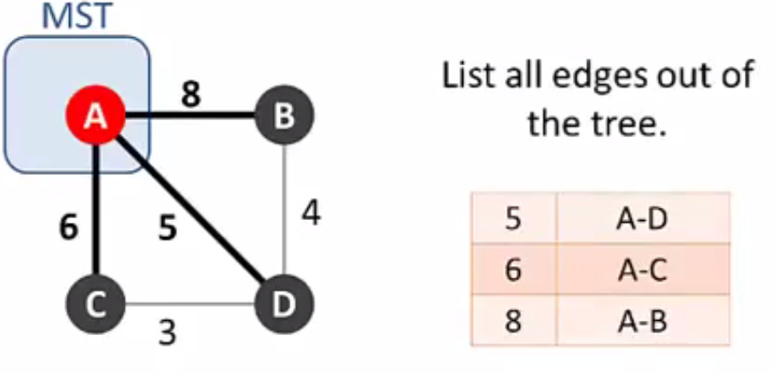
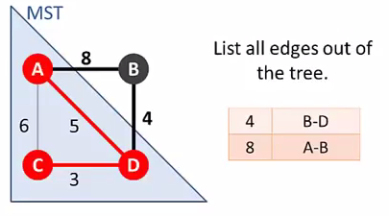
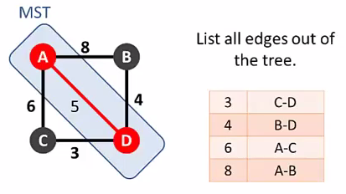
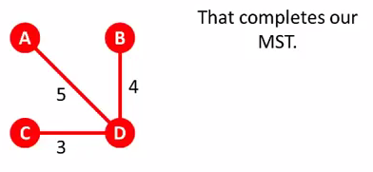


Prim’s Algo - Algorithm
Prim's algorithm is a greedy algorithm that finds a minimum spanning tree for a weighted undirected graph. This means it finds a subset of the edges that forms a tree that includes every vertex, where the total weight of all the edges in the tree is minimized.
1
3
2
4

Slide 17
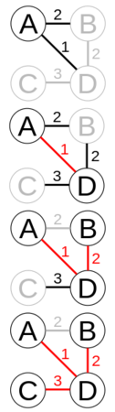
Prim’s Algorithm - MST
http://107.108.206.159/Adv_Test_Video/Prims%20Algorithm%20for%20Minimum%20Spanning%20Trees.mp4
OR
https://www.youtube.com/watch?v=MaaSoZUEoos
Another one: http://107.108.206.159/Adv_Test_Video/Kruskal's%20algorithm%20in%202%20minutes%20%97%20Review%20and%20example.mp4
Or https://www.youtube.com/watch?v=cplfcGZmX7I
C:\Users\sasikumar\Documents\Temp\SE\SE-SW COMPETENCY TASK FORCE\Classes
\\sasikumar\SW Comp -Algo Videos
Video name: Kruskals Algorithm for Minimum Spanning Trees.mp4
Prim's algorithm starting at vertex A. In the third step, edges BD and AB both have weight 2, so BD is chosen arbitrarily. After that step, AB is no longer a candidate for addition to the tree because it links two nodes that are already in the tree

Slide 18
#include<stdio.h> #include<conio.h>
int a,b,u,v,n,i,j,ne=1;
int visited[10]={0},min,mincost=0,cost[10][10];
void main()
{
printf("\n Enter the number of nodes:");
scanf("%d",&n);
printf("\n Enter the adjacency matrix:\n");
for(i=1; i<=n; i++)
for(j=1;j<=n; j++)
{
scanf("%d", &cost[i][j]);
if(cost[i][j]==0)
cost[i][j]=999;
}
visited[1]=1;
printf("\n");
while(ne<n)
{ for(i=1,min=999;i<=n;i++)
for(j=1;j<=n;j++)
if(cost[i][j]<min)
if(visited[i]!=0)
{
min=cost[i][j];
a=u=i;
b=v=j;
}
if(visited[u]==0 || visited[v]==0)
{
printf("\n Edge %d:(%d %d) cost:%d",ne++,a,b,min);
mincost+=min;
visited[b]=1;
}
cost[a][b]=cost[b][a]=999;
}
printf("\n Minimun cost=%d",mincost);
}
Prim’s –MST
 |  | 1 | 2 | 3 | 4 | 5 | 6 | 7 | 8 | 9
 |  | a | b | c | d | e | f | g | h | i
1 | a | 0 | 4 | 0 | 0 | 0 | 0 | 0 | 8 | 0
2 | b | 4 | 0 | 8 | 0 | 0 | 0 | 0 | 11 | 0
3 | c | 0 | 8 | 0 | 7 | 0 | 4 | 0 | 0 | 2
4 | d | 0 | 0 | 7 | 0 | 9 | 14 | 0 | 0 | 0
5 | e | 0 | 0 | 0 | 9 | 0 | 10 | 0 | 0 | 0
6 | f | 0 | 0 | 4 | 14 | 10 | 0 | 2 | 0 | 0
7 | g | 0 | 0 | 0 | 0 | 0 | 2 | 0 | 1 | 6
8 | h | 8 | 11 | 0 | 0 | 0 | 0 | 1 | 0 | 7
9 | i | 0 | 0 | 2 | 0 | 0 | 0 | 6 | 7 | 0
Only from visited node
If any of the node , not visited.
Set the new node visited
Replace the cost to high to avoid in next scan

Slide 19
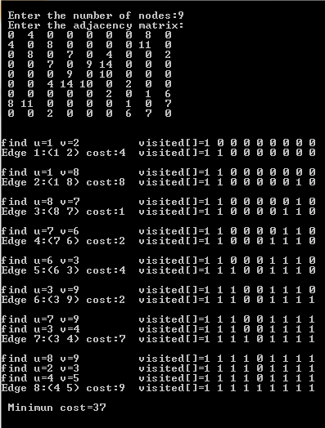


#include<stdio.h> #include<conio.h>
int a,b,u,v,n,i,j,ne=1;
int visited[10]={0},min,mincost=0,cost[10][10];
void main()
{
printf("\n Enter the number of nodes:");
scanf("%d",&n);
printf("\n Enter the adjacency matrix:\n");
for(i=1; i<=n; i++)
for(j=1;j<=n; j++)
{
scanf("%d", &cost[i][j]);
if(cost[i][j]==0)
cost[i][j]=999;
}
visited[1]=1;
printf("\n");
while(ne<n)
{ for(i=1,min=999;i<=n;i++)
for(j=1;j<=n;j++)
if(cost[i][j]<min)
if(visited[i]!=0)
{
min=cost[i][j];
a=u=i;
b=v=j;
}
if(visited[u]==0 || visited[v]==0)
{
printf("\n Edge %d:(%d %d) cost:%d",ne++,a,b,min);
mincost+=min;
visited[b]=1;
}
cost[a][b]=cost[b][a]=999;
}
printf("\n Minimun cost=%d",mincost);
}
Prim’s –MST
 |  | 1 | 2 | 3 | 4 | 5 | 6 | 7 | 8 | 9
 |  | a | b | c | d | e | f | g | h | i
1 | a | 0 | 4 | 0 | 0 | 0 | 0 | 0 | 8 | 0
2 | b | 4 | 0 | 8 | 0 | 0 | 0 | 0 | 11 | 0
3 | c | 0 | 8 | 0 | 7 | 0 | 4 | 0 | 0 | 2
4 | d | 0 | 0 | 7 | 0 | 9 | 14 | 0 | 0 | 0
5 | e | 0 | 0 | 0 | 9 | 0 | 10 | 0 | 0 | 0
6 | f | 0 | 0 | 4 | 14 | 10 | 0 | 2 | 0 | 0
7 | g | 0 | 0 | 0 | 0 | 0 | 2 | 0 | 1 | 6
8 | h | 8 | 11 | 0 | 0 | 0 | 0 | 1 | 0 | 7
9 | i | 0 | 0 | 2 | 0 | 0 | 0 | 6 | 7 | 0
The given program output choose a-h instead of b-c. Both are correct.
Already visited/connected
Already visited/connected

Slide 20
Prim’s - cpp
int main()
{
int u, v, w;
scanf("%d%d", &N, &M);
for (int i = 0; i < M; ++i)
{
scanf("%d%d%d", &u, &v, &w);
--u; --v;
adj[u][n[u]].v = v;
adj[u][n[u]++].w = w;
adj[v][n[v]].v = u;
adj[v][n[v]++].w = w;
}
for (int i = 0; i < N; ++i)
c[i] = INF;
nq = N;
int cost = 0;
while (nq--)
{
int min = (INF + 1), u;
for (int i = 0; i < N; ++i)
if (!visited[i] && c[i] < min)
{
min = c[i];
u = i;
}
if (min < INF) cost += min;
visited[u] = 1;
for (int i = 0; i < n[u]; ++i)
{
Pair p = adj[u][i];
if (!visited[p.v] && p.w < c[p.v])
c[p.v] = p.w;
}
}
printf("%d\n", cost);
return 0;
}
#include <iostream>
const int MX = 1000;
const int INF = 10007;
struct Pair { int v, w; };
Pair adj[MX][MX];
int N, M, n[MX], c[MX], nq, visited[MX];

Slide 21
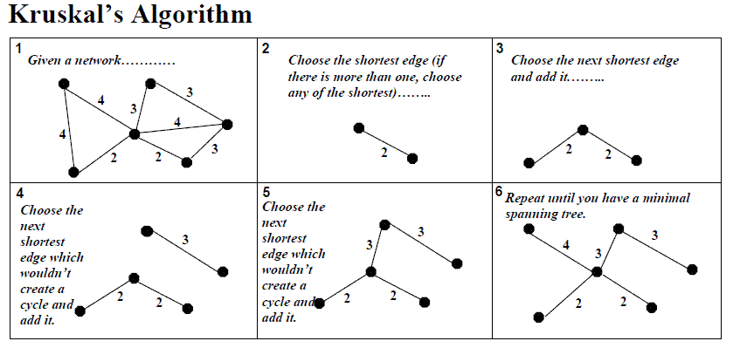
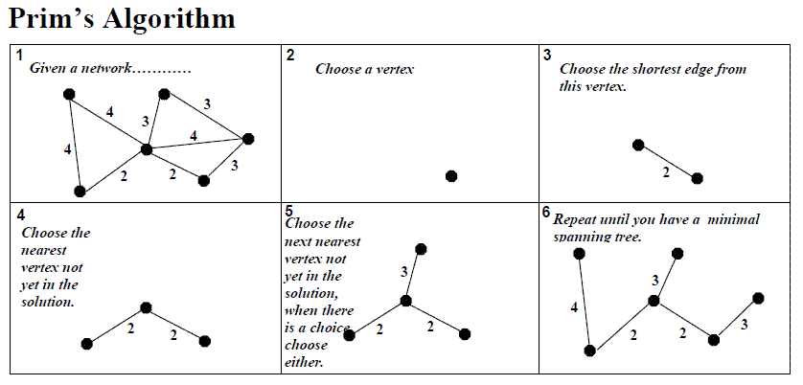
Kruskal’s & Prim’s Algo difference
For a graph with V vertices E edges,
Kruskal's algorithm runs in O(E log E) time and
Prim's algorithm can run in O(E log V)
1. Kruskal will work for disconnected graph...prim will not help in that.
2. Better to use Prims if graph is very dense in respect of no. of edges.
3. Kruskal's builds a minimum spanning tree by adding one edge at a time. The next line is always the shortest (minimum weight) ONLY if it does NOT create a cycle.
Prims builds a mimimum spanning tree by adding one vertex at a time. The next vertex to be added is always the one nearest to a vertex already on the graph
Another Code, different way of implementation
1. http://www.geeksforgeeks.org/greedy-algorithms-set-2-kruskals-minimum-spanning-tree-mst/ (for Kruskal Algorithm)
2. http://www.geeksforgeeks.org/greedy-algorithms-set-5-prims-minimum-spanning-tree-mst-2/ (for Prim's Algorithm)

Slide 22
NEXT SESSION
Next Session
Shortest Path Algo – Dijkstra’s & Bellman Ford & Floyds Warshall
VIDEO:
Shortest Path (3 Algo - Dijstras, Bellman Ford, Floyds Warshall) http://stackoverflow.com/questions/11704643/am-i-right-about-the-differences-between-floyd-warshall-dijkstras-and-bellman

